Slide 1
Lesson 1:
Introduction to Databases
CSC430/530 – DATABASE MANAGEMENT SYSTEMS

Slide 2
OUTLINE
Introduction.
Database concept overview.
Database management system (DBMS).
Overview of database design process.
Characteristics of database approach.

Slide 3
INTRODUCTION (1)
Why study databases?
Academic.
Databases involve many aspects of computer science.
Active area of research.
Developer.
A wide array of applications involve using or accessing databases.
Business.
Every organization needs databases.
Student.
Easier to get hired.

Slide 4
INTRODUCTION (2)
Databases are everywhere:
Bank withdrawal or deposit.
Hotel or airline reservation.
Groceries shopping.
Online shopping.
More examples?
Generally, databases can be divided into two classes:
Traditional databases.
Store numeric and textual information.
Non-traditional databases.
Store information generated on the web (posts, tweets, images, videos, webpages).
Big data storage systems and NOSQL (Not Only SQL) databases.

Slide 5
DATABASE CONCEPT OVERVIEW
Definition 0: Database is a collection of related data.
Data - known facts that can be recorded and that have implicit meaning.
Database properties:
Represents some aspect of the real world (mini-world).
Logically coherent collection of data with inherent meaning.
Designed, built, and populated with data for a specific purpose.
Database has:
Source from which data is derived.
Interaction with events in the real world.
Audience that is actively interested in its contents.

Slide 6
DATABASE MANAGEMENT SYSTEM (1)
Database management system (DBMS) - general-purpose software system that allows users to
create and maintain a database.
Typical DBMS functionality:
Define database.
Construct database.
Manipulate database.
Share database.
Protect database.
Maintain database.

Slide 7
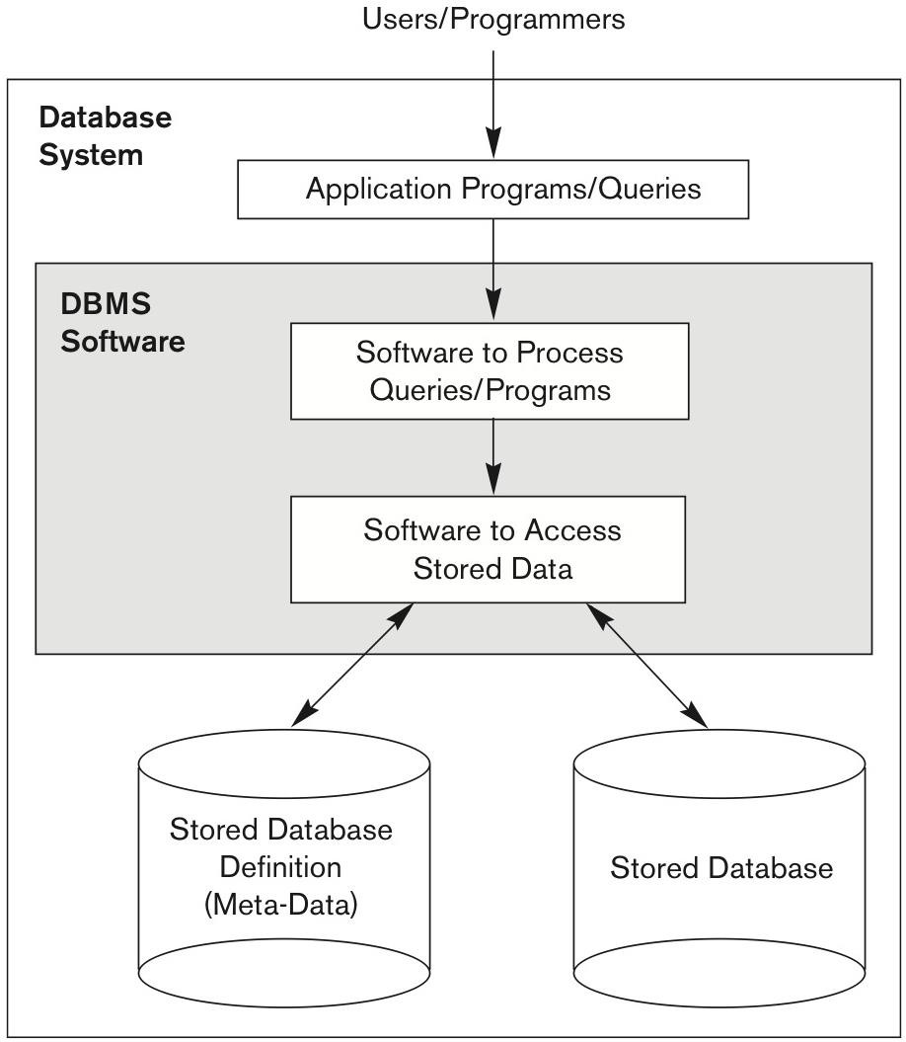
DATABASE MANAGEMENT SYSTEM (2)
Database system = DBMS software + database itself.
Simplified Database System Environment

Slide 8
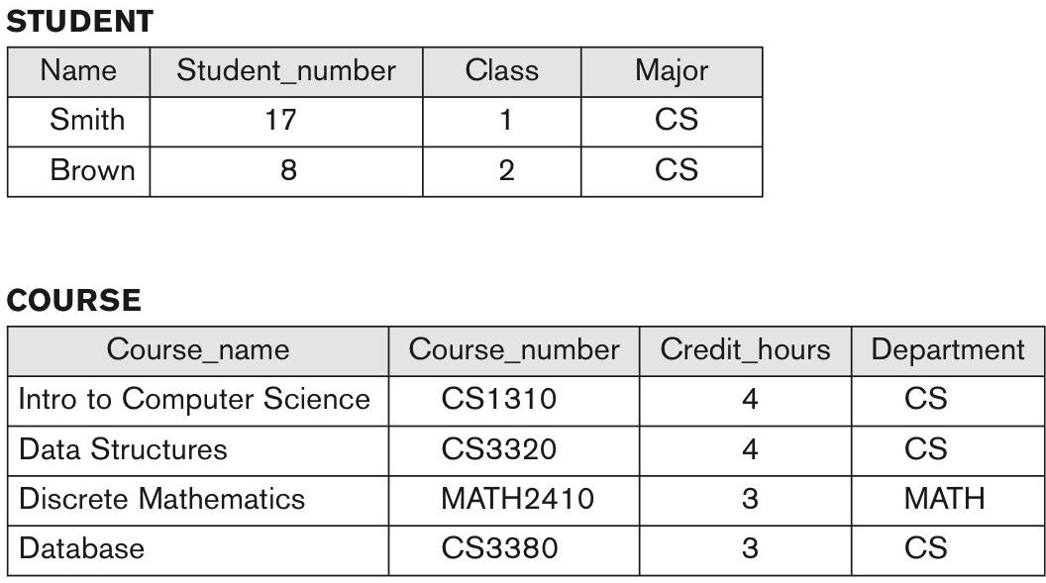
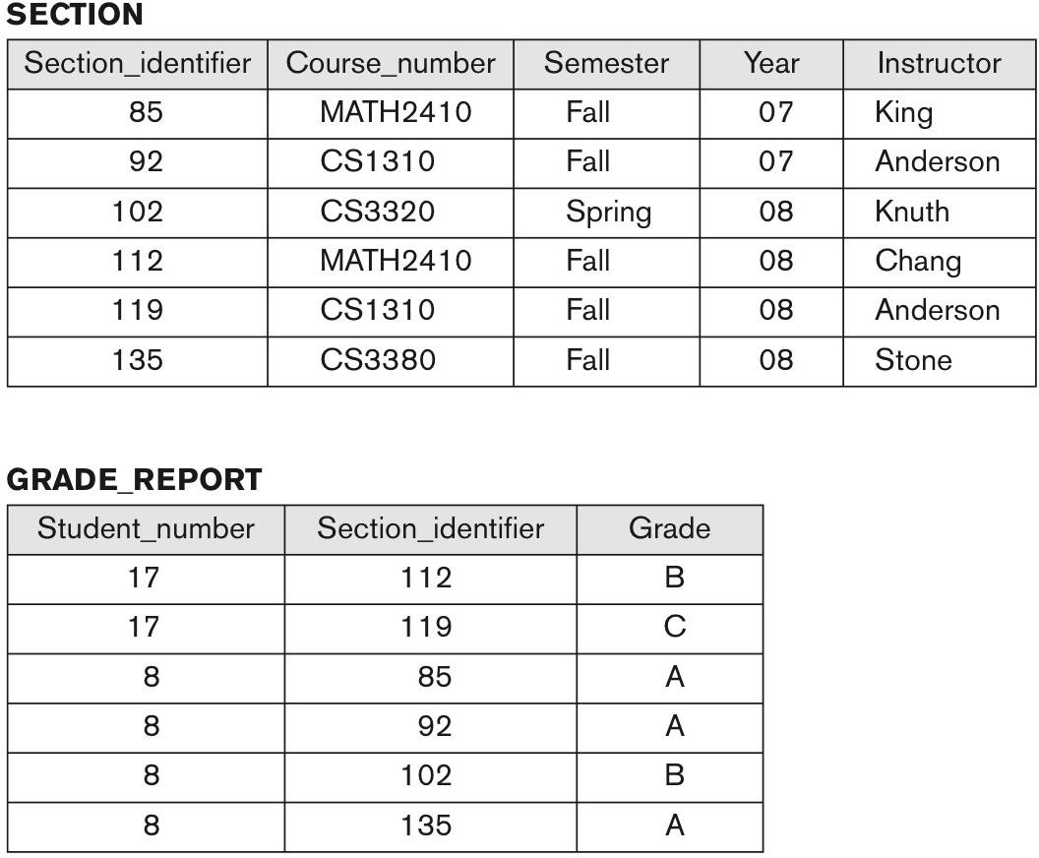
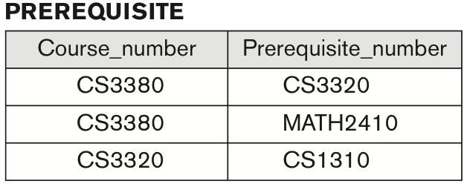
DATABASE EXAMPLE
Five files/tables (each store data records of the same type):
Student, Course, Section, Prerequisite, and Grade report.
University Database Example

Slide 9
OVERVIEW OF DATABASE DESIGN PROCESS
Database design stages:
Requirements specification and analysis.
Conceptual design.
Entity-relationship and enhanced entity-relationship models.
Logical design.
Relational DBMS.
Physical design.
The database is
implemented,
populated with an actual data, and
continuously maintained to reflect the state of the mini-world.

Slide 10
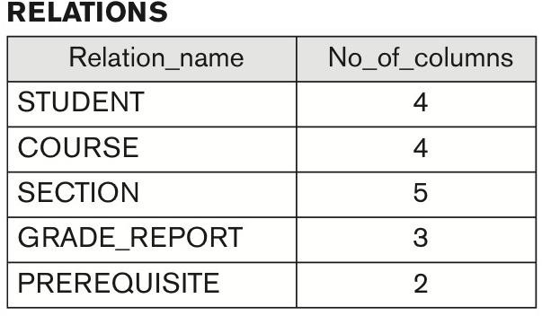
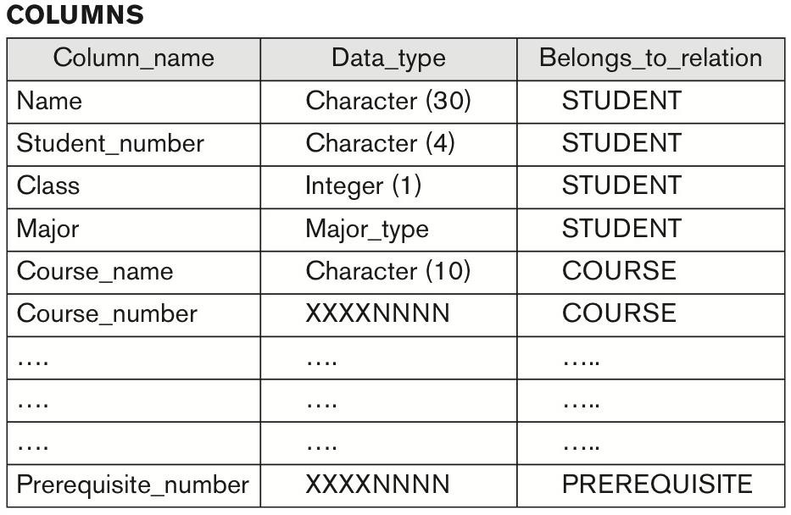
CHARACTERISTICS OF DATABASE APPROACH (1)
Characteristics of database approach:
Self-describing nature.
Definition of data is stored in the DBMS catalog (meta-data).
Insulation between programs and data.
Program-data independence.
Data abstraction.
Data model is used to hide storage details and present the users with a conceptual view of the database.
University Database Catalog

Slide 11
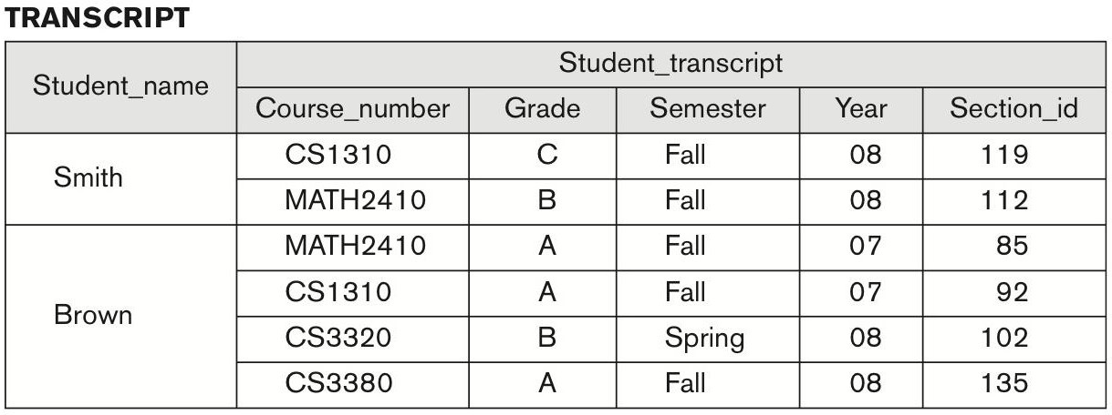
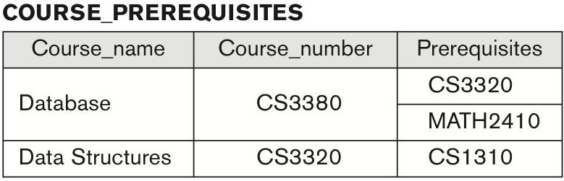
CHARACTERISTICS OF DATABASE APPROACH (2)
Characteristics of database approach (cont.):
Support of multiple views of the data.
User may see a different view of the database, which describes the data of interest to that user.
Sharing of data and multi-user transaction processing.
Allowing a set of concurrent users to retrieve from and to update the database.
Two Views Derived From University Database

Slide 12
SUMMARY
Database definition and properties.
DBMS definition and functionality.
Concept of database system.
Database design stages.
Characteristics of database approach.

